Slide 1
AWS Demo

Slide 2
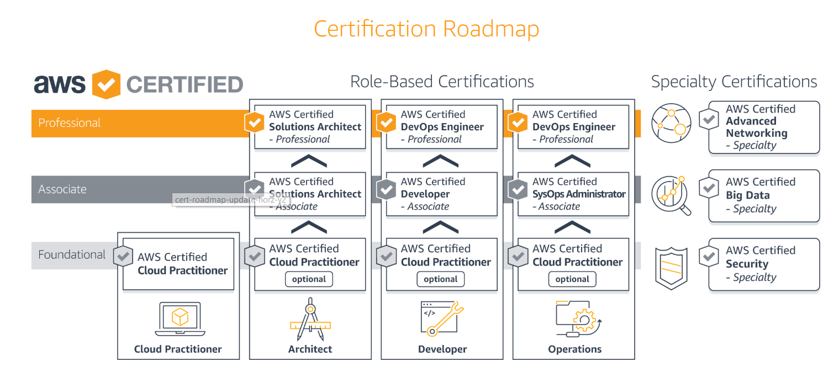
Certification Roadmap

Slide 3
